Slide 1
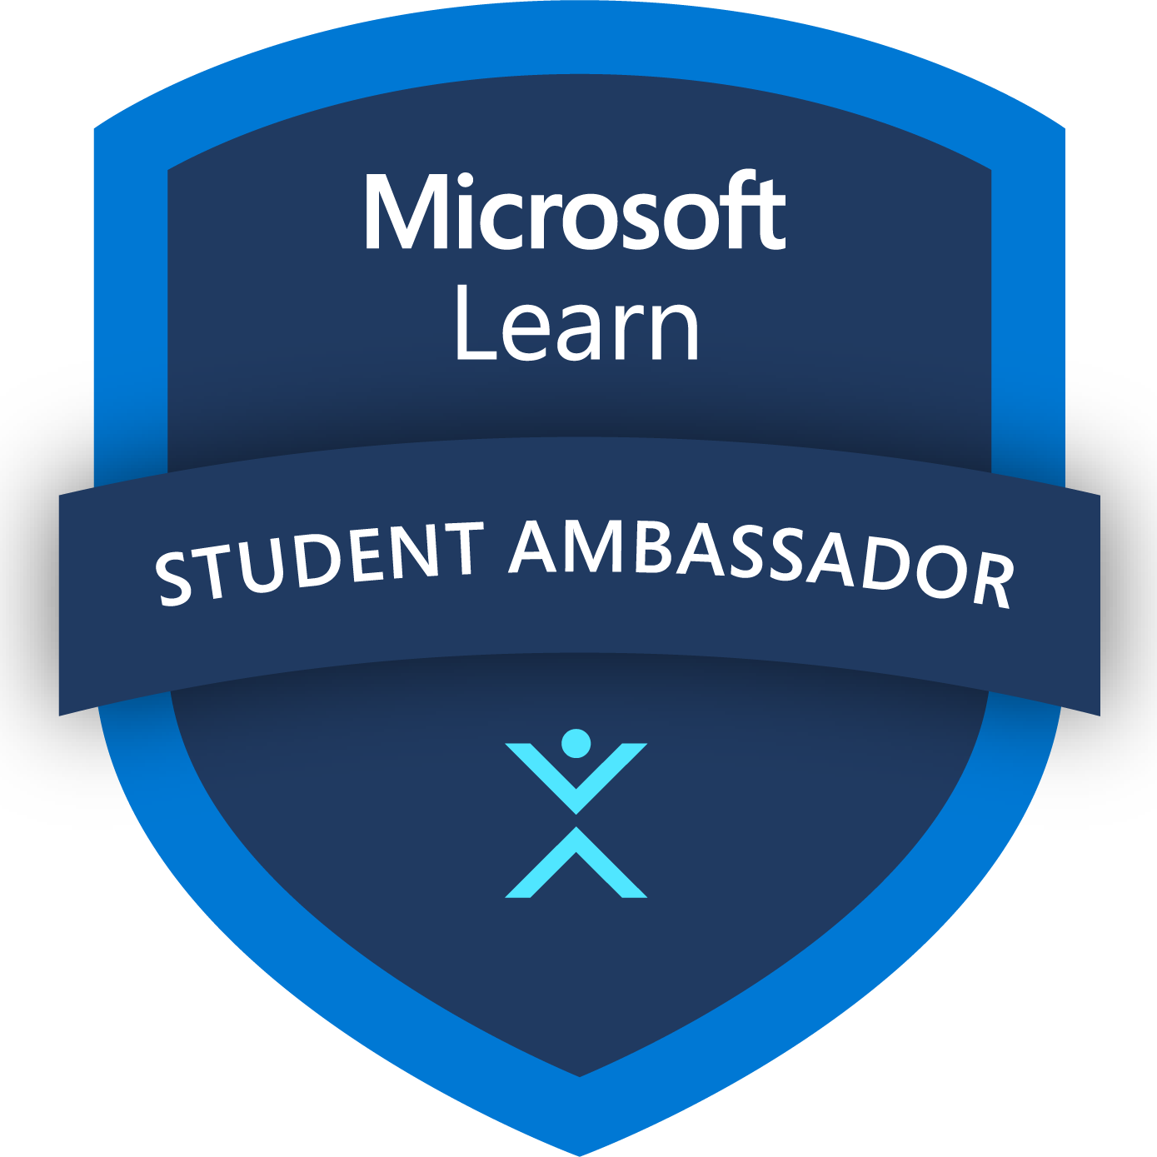
Student Ambassador Projects
Ambassador Projects Template Deck
Notes:
Korrie

Slide 2
Sandcastle Creator Solution Type: Prototype
Mrudula Rahate
Notes:
Korrie

Slide 3
The Opportunity
Industry Trends
Growing demand for accessible technology in education.
Increased integration of AI in personalized learning tools.
Rising awareness of the importance of inclusive digital solutions.
Pain Points
Lack of engaging tools for learning Braille.
Limited resources for Arabic Braille education.
Accessibility barriers in traditional learning methods.
Opportunities
Innovate with AI-driven, interactive educational games.
Address the needs of Arabic-speaking visually impaired individuals.
Pioneer in the development of inclusive and engaging educational tools
Notes:
Korrie
updated 7/21

Slide 4
Solution
Addressing the gap in Arabic Braille education with innovative technology.
AI-powered game making learning Braille engaging and accessible.
Designed with empathy, focused on inclusivity, and ease of use.
Notes:
Korrie
updated 7/21

Slide 5
Demo
https://drive.google.com/file/d/1G6DHhNJxUXGo58Y5bnMgoZBTnBDJ6Kgn/view?usp=drive_link
Notes:
Korrie
updated 7/21

Slide 6
Takeaways
Stop relying on outdated methods—they’re holding back progress.
Start embracing AI-driven tools for a more inclusive learning experience.
With us, learning Arabic Braille becomes faster, easier, and more cost-effective.
Notes:
Korrie
updated 7/21

